Slide 1
CLINICAL CASE
03-2019
Here is where your presentation begins

Slide 2
01
02
03
04
TABLE OF CONTENTS
05
06
ABOUT THE PATIENT
DISCUSSION
Here you could describe the topic of the section
Here you could describe the topic of the section
DIAGNOSIS
TREATMENT
Here you could describe the topic of the section
Here you could describe the topic of the section
PATIENT MONITORING
CASE TIMELINE
Here you could describe the topic of the section
Here you could describe the topic of the section

Slide 3
INTRODUCTION
Mercury is the closest planet to the Sun and the smallest one in the Solar System—it’s only a bit larger than our Moon. The planet’s name has nothing to do with the liquid metal, since it was named after the Roman messenger god, Mercury

Slide 4
IDENTIFYING INFORMATION
VENUS
MARS
Venus has a beautiful name and is the second planet from the Sun. It’s terribly hot and its atmosphere is extremely poisonous
Despite being red, Mars is a cold place, not hot. It’s full of iron oxide dust, which gives the planet its reddish cast
MERCURY
JUPITER
Mercury is the closest planet to the Sun and the smallest one in the Solar System—it’s only a bit larger than our Moon
Jupiter is a gas giant and the biggest planet in our Solar System. It’s also the fourth-brightest object in the sky

Slide 5
PATIENT MEDICAL HISTORY
Age: 25 - 35
Gender: Female
Allergies: None
Location: Madrid, Spain
 | MOTHER | FATHER | SIBLINGS
DISEASE 1 | Former patient | — | —
DISEASE 2 | Former patient | — | Former patient
DISEASE 3 | — | Former patient | —
DISEASE 4 | — | — | Former patient

Slide 6
PATIENT MEDICAL HISTORY
VENUS
SATURN
MARS
Venus has a beautiful name, but it’s terribly hot
Saturn is composed mostly of hydrogen and helium
Despite being red, Mars is a cold place, not hot
2005
2008
2014

Slide 7
REVIEW OF SYSTEMS
MERCURY
VENUS
It’s the closest planet to the Sun
It has a beautiful name
It’s the smallest one in our Solar System
It’s the second planet from the Sun
It’s only a bit larger than our Moon
It’s even hotter than Mercury
It was named after the Roman messenger god
Its atmosphere is extremely poisonous

Slide 8
PHYSICAL EXAMINATION
VENUS
SATURN
Venus has a beautiful name and is the second planet from the Sun
Saturn is the ringed one. It’s composed mostly of hydrogen and helium
NEPTUNE
MARS
JUPITER
Neptune is the fourth-largest planet in our Solar System
Despite being red, Mars is a cold place, not hot. It’s full of iron oxide dust
Jupiter is a gas giant and the biggest planet in our Solar System

Slide 9
RESULTS
CLINICAL CASE
TEST 1
TEST 2
Venus has a beautiful name, but it’s terribly hot
Mercury is the smallest planet in our Solar System
Saturn is composed mostly of hydrogen and helium
Neptune is the farthest planet from the Sun

Slide 10
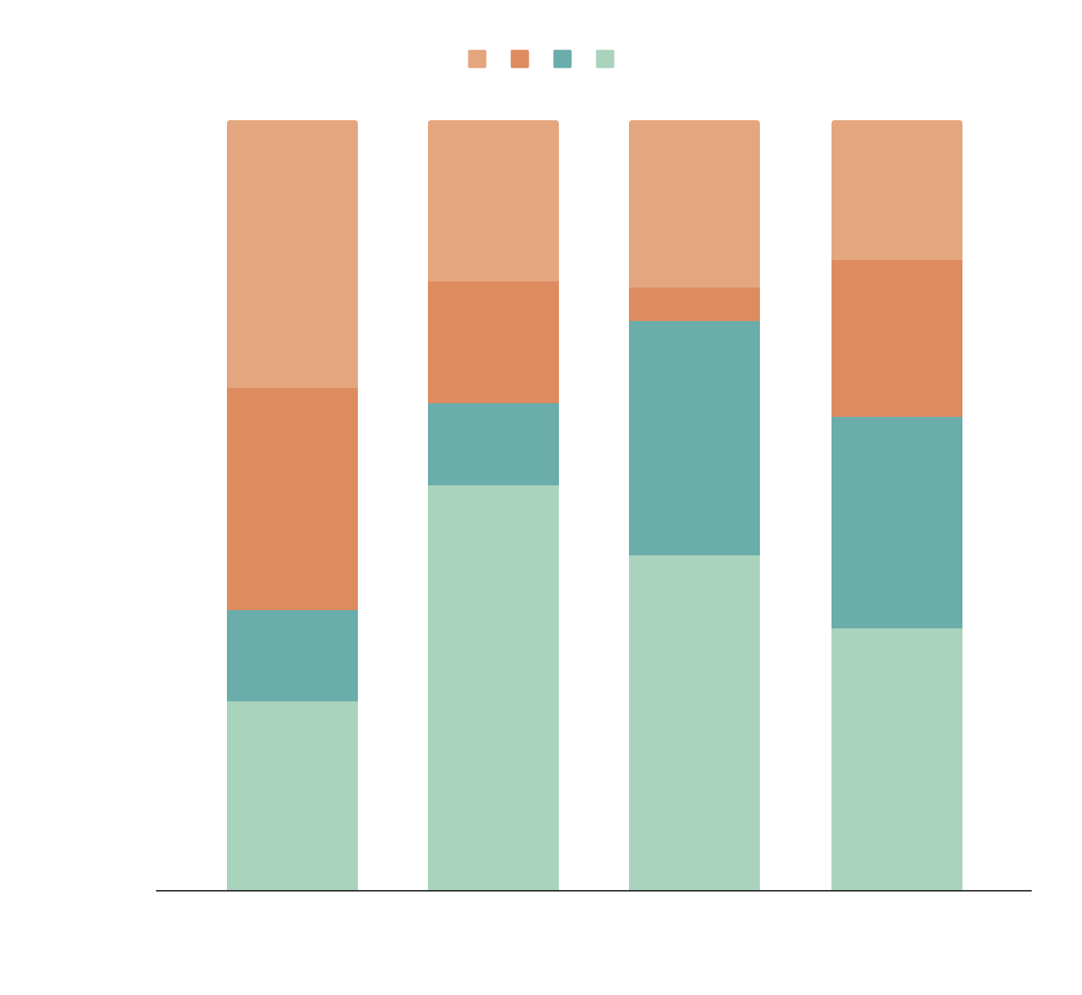
EVOLUTION
PREVALENCE
FINDINGS
200,000,000
If you want to modify this graph, click on it, follow the link, change the data and replace it
BIG NUMBER

Slide 11
DISCUSSION SUMMARY
Dr. John Doe
“Saturn is the ringed one. It’s a gas giant, composed mostly of hydrogen and helium”
Dr. Jenna James
“Mercury is the closest planet to the Sun and the smallest one in our Solar System”
Dr. Daniel Patterson
“Jupiter is a gas giant and the biggest planet in our Solar System”
Dr. Samantha Ortega
“Despite being red, Mars is a cold place, not hot. It’s full of iron oxide dust”

Slide 12
DISCUSSION SUMMARY
A
B
C
Mercury is the closest planet to the Sun and the smallest one in the Solar System—it’s only a bit larger than our Moon
Despite being red, Mars is a cold place, not hot. It’s full of iron oxide dust, which gives the planet its reddish cast
Jupiter is a gas giant and the biggest planet in our Solar System. It’s also the fourth-brightest object in the sky

Slide 13
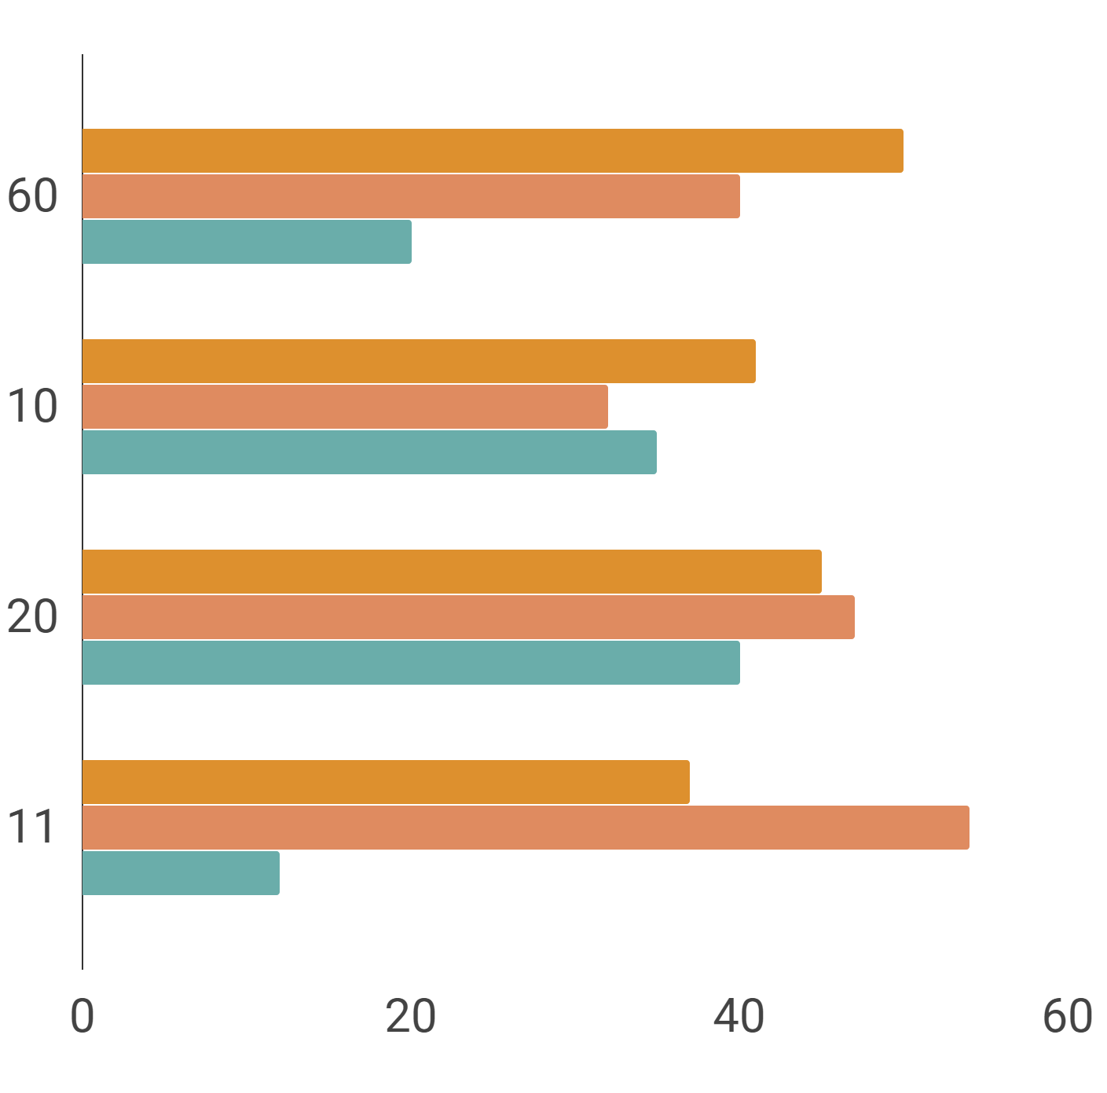
COMPARISON
CASE A
CASE B
MARS
VENUS
SATURN

Slide 14
DIAGNOSIS
Mercury is the closest planet to the Sun and the smallest one in the Solar System—it’s only a bit larger than our Moon. The planet’s name has nothing to do with the liquid metal since it was named after the Roman messenger god, Mercury

Slide 15
TREATMENT
VENUS
MERCURY
JUPITER
Venus has a beautiful name and is the second planet from the Sun
Mercury is the smallest planet in our Solar System and the closest to the Sun
Jupiter is a gas giant and the biggest planet in our Solar System
MARS
SATURN
NEPTUNE
Despite being red, Mars is a cold place, not hot. It’s full of iron oxide dust
Saturn is a gas giant, composed mostly of hydrogen and helium
Neptune is the fourth-largest planet in our Solar System

Slide 16
PATIENT MONITORING
Mercury
Venus
Saturn
Neptune
Mercury is the closest planet to the Sun and the smallest one in the Solar System—it’s only a bit larger than our Moon

Slide 17
CONTRAINDICATIONS
Here you can describe a reason to stop the treatment
Here you can describe a reason to stop the treatment
Here you can describe a reason to stop the treatment
Here you can describe a reason to stop the treatment
Here you can describe a reason to stop the treatment
Here you can describe a reason to stop the treatment
Here you can describe a reason to stop the treatment
Here you can describe a reason to stop the treatment

Slide 18
INDICATIONS
Here you can describe a reason to carry on with the treatment
Here you can describe a reason to carry on with the treatment
Here you can describe a reason to carry on with the treatment
Here you can describe a reason to carry on with the treatment

Slide 19
01
02
03
04
POST-PREVENTION
Saturn is the ringed one. It’s composed mostly of hydrogen and helium
Venus has a beautiful name and is the second planet from the Sun
Despite being red, Mars is a cold place, not hot. It’s full of iron oxide dust
Jupiter is a gas giant and the biggest planet in our Solar System

Slide 20
CASE TIMELINE
DAY 1
DAY 2
DAY 3
DAY 4
DAY 5
2.
Mercury is the closest planet to the Sun
3.
Saturn is composed mostly of hydrogen and helium
4.
Despite being red, Mars is a cold place, not hot
1.
Jupiter is the biggest planet in our Solar System

Slide 21
CONCLUSIONS
Mercury is the closest planet to the Sun and the smallest one in the Solar System—it’s only a bit larger than our Moon. The planet’s name has nothing to do with the liquid metal since it was named after the Roman messenger god, Mercury

Slide 22
REFERENCES
AUTHOR (YEAR). Title of the publication. Publisher
AUTHOR (YEAR). Title of the publication. Publisher
AUTHOR (YEAR). Title of the publication. Publisher
AUTHOR (YEAR). Title of the publication. Publisher
AUTHOR (YEAR). Title of the publication. Publisher
AUTHOR (YEAR). Title of the publication. Publisher

Slide 23
OUR TEAM
Dr. Jenna Doe
Dr. Amanda Patterson
You can replace the image on the screen with your own
You can replace the image on the screen with your own

Slide 24
THANKS
Does anyone have any questions?
addyouremail@freepik.com
+91 620 421 838
yourcompany.com

Slide 25
CREDITS
This is where you give credit to the ones who are part of this project.
Did you like the resources on this template? Get them for free at our other websites.
Presentation template by Slidesgo
Icons by Flaticon
Infographics by Freepik
Images created by Freepik
Text & Image slide photo created by Freepik.com

Slide 26
RESOURCES
Vector
Medicaments
Medical
Hospital line craft
Hand drawn nurse helping patient background
Hand drawn nurse taking care patient
Hand drawn nurse taking care of patient Free Vector
Hand drawn nurse helping patient background Free Vector

Slide 27
Instructions for use
In order to use this template, you must credit Slidesgo by keeping the Credits slide.
You are allowed to:
- Modify this template.
- Use it for both personal and commercial projects.
You are not allowed to:
- Sublicense, sell or rent any of Slidesgo Content (or a modified version of Slidesgo Content).
- Distribute Slidesgo Content unless it has been expressly authorized by Slidesgo.
- Include Slidesgo Content in an online or offline database or file.
- Offer Slidesgo templates (or modified versions of Slidesgo templates) for download.
- Acquire the copyright of Slidesgo Content.
For more information about editing slides, please read our FAQs:
https://slidesgo.com/faqs

Slide 28
Fonts & colors used
This presentation has been made using the following fonts:
Reem Kufi
(https://fonts.google.com/specimen/Reem+Kufi)
Anaheim
(https://fonts.google.com/specimen/Anaheim)
#6aadaa
#aad3bd
#cbe5dd
#df8b60
#dd902e
#eecac8

Slide 29
Use our editable graphic resources...
You can easily resize these resources keeping the quality. To change the color just ungroup the resource and click on the object you want to change. Then click on the paint bucket and select the color you want. Don’t forget to group the resource again when you’re done.

Slide 31
...and our set of editable icons
You can resize these icons keeping the quality.
You can change the stroke and fill color; just select the icon and click on the paint bucket/pen.

Slide 32
Business Icons

Slide 33
Avatar Icons

Slide 34
Creative Process Icons

Slide 35
Educational Process Icons

Slide 36
Help & Support Icons

Slide 37
Medical Icons

Slide 38
Nature Icons

Slide 39
Performing Arts Icons

Slide 40
SEO & Marketing Icons

Slide 41
Teamwork Icons

Slide 42


